Slide 1

“An Overview of Research Papers Analysis Regarding Road Scene Analysis”
Supervisor : MD. Tamim Hossain
Presented By : Anika Tahasin

Slide 2

Studied Papers & Identified Categories
A: Detection & Segmentation
B: Anomaly & Accident Detection
C:Environment & Condition Analysis
2

Slide 3
Identified Patterns
Strong Focus on Road Scene Understanding
Three Major Research Directions
Shift Toward Handling Real-World Challenges
Use of Deep Learning Across All Papers
Safety and Reliability as the Core Goal
Move From Simple Detection → Understanding Full Scene Context
Increasing Focus on Unlabeled or Unknown Situation
2

Slide 4
Category A: Detection & Segmentation
Key Insights and Findings:
Accurate object detection (cars, bikes, pedestrians) is the foundation of road scene understanding.
Semantic segmentation helps identify drivable vs. non-drivable areas.
3D layout prediction helps understand hidden or occluded regions.
Models can perform well even in unstructured roads such as villages, narrow lanes, and traffic-heavy Bangladeshi roads.
2
3

Slide 5
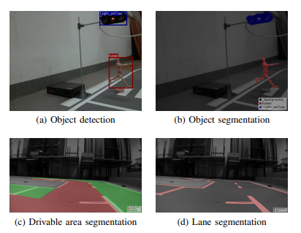
Example & Findings (Category A) :
Example:
Model detects a pedestrian, a rickshaw, and a pothole in a bike-mounted video.
Bounding boxes show the objects
Lane markings are segmented
The system identifies that the bike is approaching a pothole within 2 seconds
***Examples of training sets. Set (b) was generated for the MultiTask V3 network only, and sets (a), (c) and (d) for all models

Slide 6
Conclusion & Implementation:
Category A papers build the foundation for any road scene analysis system.
They ensure the model can see, classify, and understand the environment before predicting actions or risks.
1. Object Detection (Pedestrian, Vehicle, Pothole, Animal)
Use YOLOv8/YOLOv9/YOLOv11 (nano or small model)
2. Lane & Road Segmentation
Use DeepLabv3, Fast-SCNN, or YOLO-World segmentation
3.Object Tracking (to detect actions over time)
Use DeepSORT or ByteTrack
4. Action Recognition (Frequent / Moderate / Rare)
Combine detection + tracking
2
3

Slide 7
Category B: Anomaly & Accident Detection
Key Insights and Findings:
Unsupervised models can detect abnormal events without needing labeled accident data.
Models capture unusual motion patterns, sudden stops, sharp turns, and collisions.
Systems can identify unknown objects and rare events that normal detectors miss.
First-person camera views (helmet, dashcam) give strong signals for accident prediction.
2
3

Slide 8
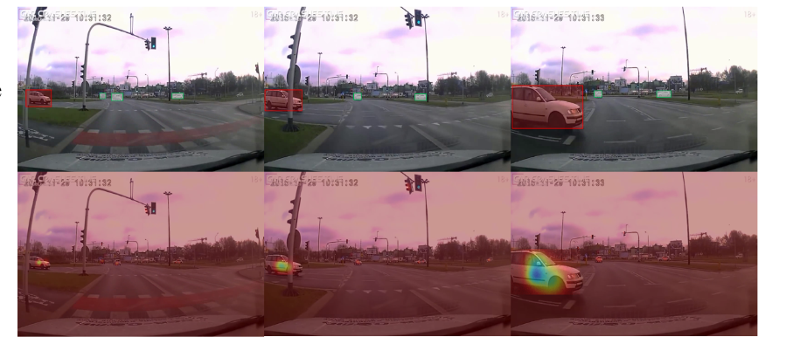
Example & Findings (Category B) :
Example:
The system notices a sudden change in object motion:
A child runs into the road unexpectedly
A bike in front slips
A vehicle suddenly appears from the wrong direction
***When a vehicle suddenly cuts in, its attention score increases as it approaches, indicating its growing importance as a potential anomaly.

Slide 9
Conclusion & Implementation:
Category B focuses on safety-critical detection.
It understands not only what is present but also what is unusual or dangerous in a scene.
1. Sudden Movement / Abnormal Behaviour
Use Optical Flow (RAFT, LiteFlowNet, Farneback)
2. Accident or Dangerous Event Detection
Train a simple autoencoder
3. Time-to-Collision (TTC)
Calculate distance between your camera and object
4. Danger / Accident Classifier
Train a small classifier (CNN or LSTM) on short video clips
2
3

Slide 10
Category C: Environment & Condition Analysis
Key Insights and Findings:
Hyperspectral imaging provides material-level road information (wet, dry, slippery, mud, sand).
Environment-feature detection helps identify infrastructure, such as sidewalks, crosswalks, poles, signboards.
Pedestrian risk prediction depends heavily on environment context, not only moving objects.
Improves understanding of static and subtle environmental cues.
2
3

Slide 11
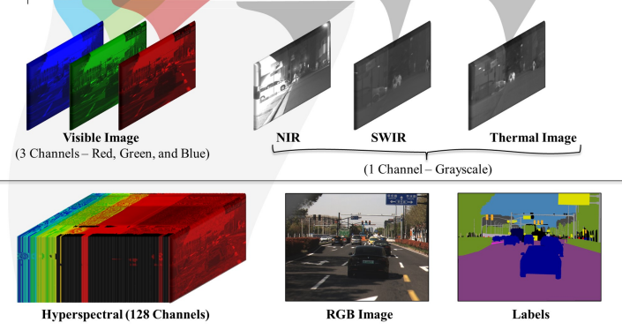
Example & Findings (Category C) :
Example:
The system detects environmental states:
Low visibility due to dust or fog
Wet or shiny road surfaces
Shadow regions causing difficulty in object detection
***Comparative Overview of Imaging Modalities Across the Electromagnetic Spectrum

Slide 12
Conclusion & Implementation:
Category C adds environment depth, providing information that normal RGB-based perception cannot capture.
It strengthens the system by adding context and material awareness.
1. Road Surface Condition Detection (wet, dry, muddy, sand, broken)
Train a classifier (CNN, MobileNet)
2. Lighting & Visibility Classification (day/night, fog, haze, low-light, shadow)
Use a small CNN or Vision Transformer
3. Weather Tagging (rain, dust, clear, fog)
Use frame-level or clip-level classifier
2
3

Slide 13
THANK
YOU
PREMIERE UNIVERSITY

